Slide 1


<Name>
<Date>

Slide 2

Outline
Executive Summary
Introduction
Methodology
Results
Conclusion
Appendix

Slide 3
Executive Summary
Methodologies were used in the project:
Data collection via API
Data collection Webscraping
Data Wrangling
Data Analysis by using SQL
Visualization of Data analysis
Predication by using Machine Learning
Summary of all results
Exploratory data analysis result
Predictive analysis result
Interactive dashboards for visualization of data analisys

Slide 4
Introduction
Target of this project is investigation how successful were launched of Falcon 9 rocket by company Space X to determine if their technology can be used for launch of rockets and calculate cost of launch
Problems we want to solve:
To decide which method will be opimal for estimation of launch
To determine the best parameters for successful landing
To determine cost of each launch

Slide 5

Section 1

Slide 6
Methodology
Executive Summary
Data collection methodology:
There are some ways to collect data for project:
REST API technology
Web scrapping from Wiki and using BeautifulSoup package
Perform data wrangling
Filter data for the Falcon 9 only and one-hot encoding for categorical features
Perform exploratory data analysis (EDA) using visualization and SQL
Perform interactive visual analytics using Folium and Plotly Dash
Perform predictive analysis using classification models
To predictive analysis used Line Regression, Decision Tree, Logistic Regression etc models

Slide 7
Data Collection
Describe how data sets were collected.
There are some ways to collect data for project:
REST API technology (api.spacexdata.com/v4/launches/past)
Web scrapping from Wiki and using BeautifulSoup for cleaning data
You need to present your data collection process use key phrases and flowcharts
In order to use REST API for collection data we used the Python libraries:
the json function to extract data, json_normalize() to transformed result and write it to the pandas dataframe.
To finalize of collection data was checked for missing values and updated where necessary.
In order to use web scrapping we used BeautifulSoup library to parse data extractedas HTML table and convert to the pandas dataframe

Slide 8
Data Collection – SpaceX API
Data collection using REST API:
Get requet for rocket launch data
Convert the json result using json_normalize
Cleaning data (remove rows with multiply cores, payloads, convert data_utc to data_type format)
Github URL: https://github.com/Inka611/Data-Science-Capstone-Project1/blob/3a7ff313ca3a342f3a0374954536c783f7801419/jupyter-labs-spacex-data-collection-api-final.ipynb
Get requests for rocket launch data using Rest API: spacex_url=https://api.spacexdata.com/v4/launches/past
response = requests.get(spacex_url)
Use json_normalize meethod to convert the json result into a dataframe
r1 = response.json()
data = pd.json_normalize(r1)
Take a subset of our dataframe keeping only the features we want, remove rows with multiple cores because those are falcon rockets with 2 extra rocket boosters and rows that have multiple payloads in a single rocket.
data = data[data['cores'].map(len)==1]
data = data[data['payloads'].map(len)==1]
extract the single value in the list and replace the feature.
data['cores'] = data['cores'].map(lambda x : x[0])
data['payloads'] = data['payloads'].map(lambda x : x[0])
convert the date_utc to a datetime datatype and then extracting the date leaving the time
data['date'] = pd.to_datetime(data['date_utc']).dt.date

Slide 9
Data Collection - Scraping
Data collection using Web scraping:
By using HTTP GET method to request the Falcon9 Launch HTML page
Create a BeautifulSoup object from the HTML response
Create a data frame by parsing the launch HTML tables
Export to csv
Add the GitHub URL https://github.com/Inka611/Data-Science-Capstone-Project1/blob/fcbf3f19f9b0693a05c9e0b166fdf67f689fc7bd/jupyter-labs-webscraping_final.ipynb
static_url = https://en.wikipedia.org/w/index.php?title=List_of_Falcon_9_and_Falcon_Heavy_launches&oldid=1027686922
# use requests.get() method with the provided static_url
# assign the response to a object
response=requests.get(static_url)
# Use BeautifulSoup() to create a BeautifulSoup object from a response text content
soup = BeautifulSoup(response.text, 'html.parser')
extracted_row = 0
#Extract each table
for table_number,table in enumerate(soup.find_all('table',"wikitable plainrowheaders collapsible")):
# get table row
for rows in table.find_all("tr"):
if rows.th:
if rows.th.string:
flight_number=rows.th.string.strip()
flag=flight_number.isdigit()
df.to_csv('spacex_web_scraped.csv', index=False)

Slide 10
Data Wrangling
The Data Wranling stage is used to perform Exploratory Data Analysis (EDA), encoding categorical features and determine training and test data sets
Data wrangling process includes following steps:
GitHub URL :https://github.com/Inka611/Data-Science-Capstone-Project1/blob/1b2c9a31b9c5aa413d8659720db49c19a13c528a/labs-jupyter-spacex-data_wrangling_jupyterlite.jupyterlite.ipynb
1. Calculate the number of launches on each site and the number and occurrence of each orbit:
df['LaunchSite'].value_counts()
2. Create a landing outcome label from Outcome column:
landing_class=[]
for oj in df['Outcome']:
if oj in set(bad_outcomes):
landing_class.append(0)
else:
landing_class.append(1)
df['Class']=landing_class
3. Export datra set to csv df.to_csv("dataset_part_2.csv", index=False)

Slide 11
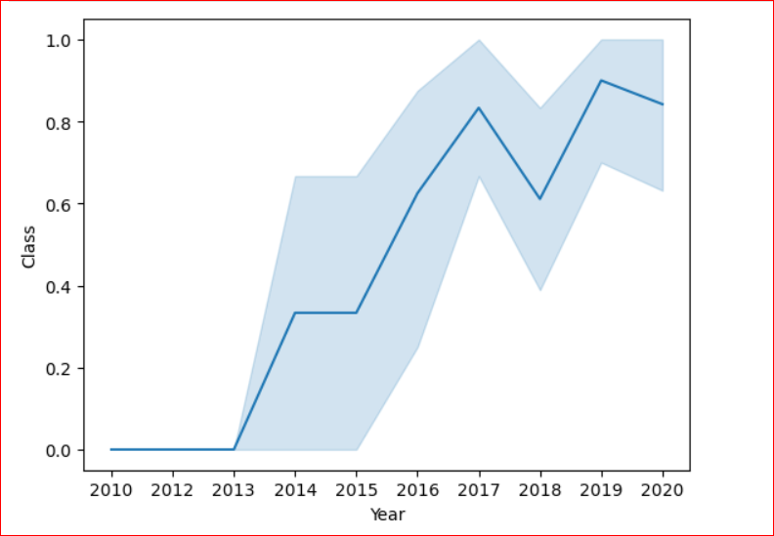
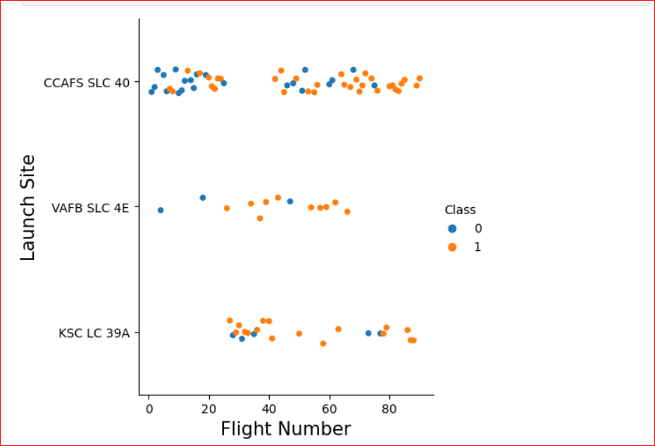
EDA with Data Visualization
The line chart with x axis to be the extracted year and y axis to be the success rate demonstrates average success rate for years
GitHub URL:https://github.com/Inka611/Data-Science-Capstone-Project1/blob/f7d9941b8b250324304ebba7643a03c99da63592/jupyter-labs-eda-dataviz.ipynb.jupyterlite_Final.ipynb
For visualization of the relationship between Flight Number and Launch Site we used the scatterplot

Slide 12
EDA with SQL
SQL queries were used to performed multiply queries:
Unique launch sites in the space mission
Total payload mass carried by boosters launched by NASA (CRS)
Average payload mass carried by booster version F9 v1.1
List the date when the first succesful landing outcome in ground pad was acheived.
List the names of the boosters which have success in drone ship and have payload mass greater than 4000 but less than 6000
Total number of successful and failure mission outcomes
List the names of the booster_versions which have carried the maximum payload mass
Rank the count of landing outcomes
Git Hub link to notebook: https://github.com/Inka611/Data-Science-Capstone-Project1/blob/f7d9941b8b250324304ebba7643a03c99da63592/jupyter-labs-eda-sql-coursera_sqllite.ipynb

Slide 13
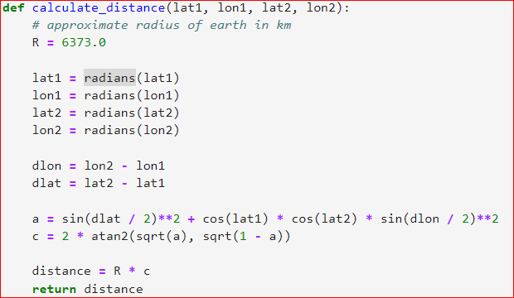
Build an Interactive Map with Folium
To build interactive Map with Folium were added objects:
Circles (to mark each Launch Site)
Markers (to mark each Launch site)
PolyLine (to demonstrate distance between Launching place and nearest city)
Objects were marked by color according to status of launch (failure or successful)
In order to determine color of the line the new column ‘marker_color’ calculated by formula spacex_df['class'].apply(lambda x: 'green' if x==1 else 'red') was added to the data frame
Distance was calculated by formula:
Git Hub link:https://github.com/Inka611/Data-Science-Capstone-Project1/blob/08808110a447370eb893a451e2568937465f1752/lab_jupyter_launch_site_location.jupyterlite.ipynb

Slide 14
Build a Dashboard with Plotly Dash
The interactive dashboard was built by using Plotly Dash in this project
The dashboards contained pie chart to show total launches for each Launch Site and Scatter plots to show relationship between Outcome and Payload Mass for booster version
On the dashboard user will have possibility to choose Launch Site from drop-down list and max and min for Payload
GitHub URL of completed Plotly Dash lab https://github.com/Inka611/Data-Science-Capstone-Project1/blob/9e9cde4cc0029fddf9d7346c1e52beab90fae593/spacex_dash_app.py

Slide 15
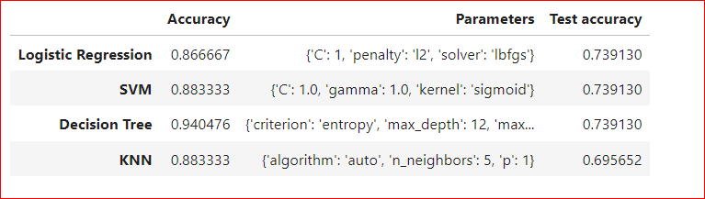
Predictive Analysis (Classification)
GitHub URL https://github.com/Inka611/Data-Science-Capstone-Project1/blob/2b5c493ea75842e4d56ed3d7d5f77be7f9892545/SpaceX_Machine_Learning_Prediction_Part_5.jupyterlite.ipynb
Bulding model:
- Load dataset by using Pandas and
Numpy
- Split entire data to training and test dataset
- create a GridSearchCV different kind(Logical Regresion, Decision Tree, SVC, KNN) and fit it (mdl.fit(X_train, Y_train))
2. Evaluating Model:
-calculate accuracy for test data (mdl.score(X_test, Y_test))
-find best hyperparameters
-create confusion matrix
3.Improve and find the best model:
-create report by models
-choose model with the best accuracy

Slide 16
Results
Exploratory data analysis results
Interactive analytics demo in screenshots
Predictive analysis results

Slide 17

Section 2

Slide 18
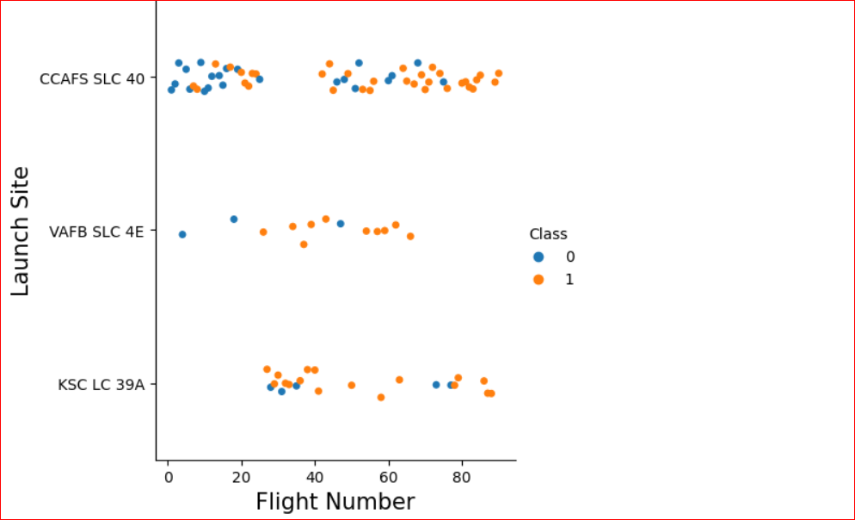
Flight Number vs. Launch Site
The scatter plot of Flight Number vs. Launch Site shows the larger the flight amount at a launch site, the greater the success rate at a launch site
Successful launch is launch with Class = 1 (orange circle),
Failure launch is launch with Class = 0 (blue circle)

Slide 19
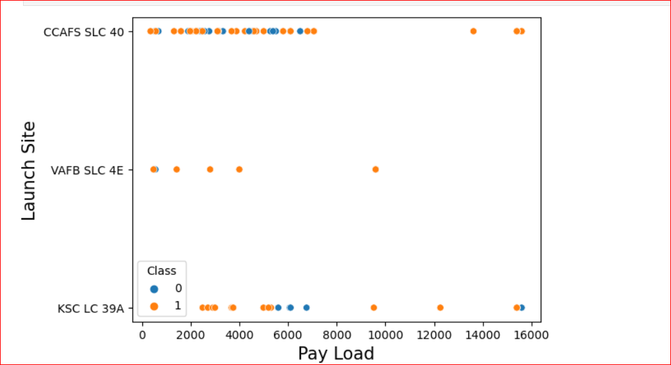
Payload vs. Launch Site
This scatter plot shows dependence between possibility of successful launch and payload mass for different launch site
It shows that possibility of successful launch increases for payload mass greater than 8000

Slide 20
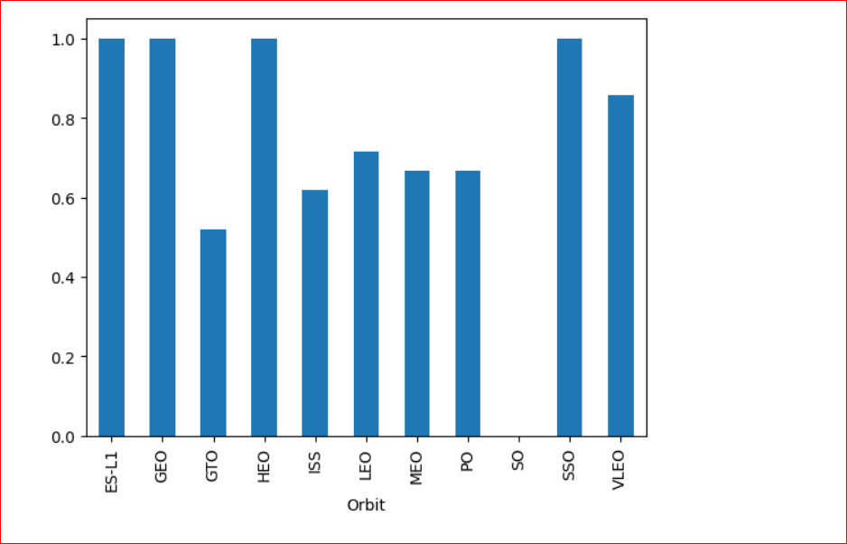
Success Rate vs. Orbit Type
The bar chart for the success rate of each orbit type
It shows that the most successful launches was for orbit type ‘ES-L1’, ‘GEO’, ‘HEO’.

Slide 21
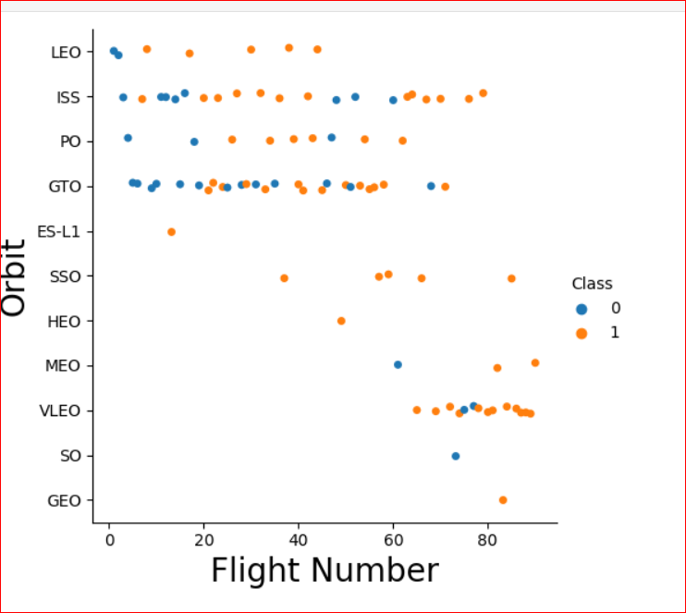
Flight Number vs. Orbit Type
This screenshot shows the scatter point of Flight number vs. Orbit type
The scatter plot shows dependence frequency of successful launches on Flight number and Orbit type

Slide 22
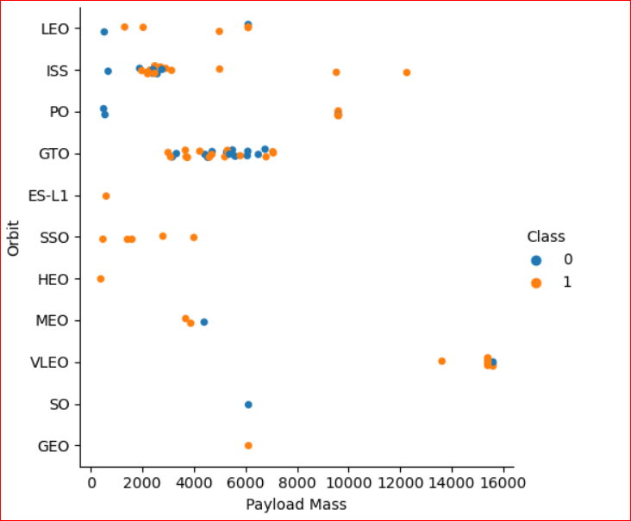
Payload vs. Orbit Type
This screenshot shows the scatter point of payload vs. orbit type
The scatter plot shows dependence frequency of successful launches on payload and orbit type

Slide 23
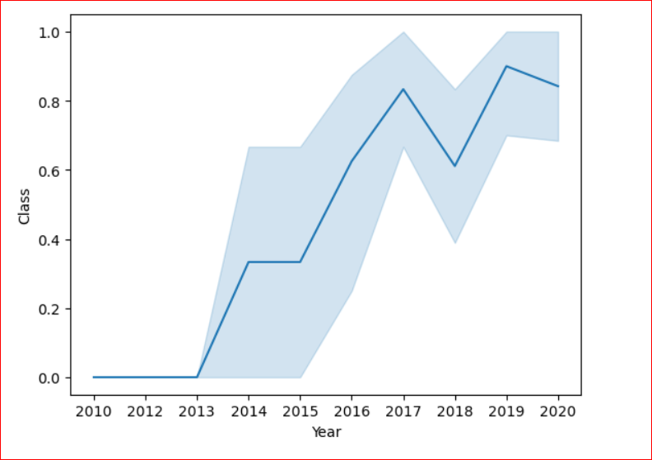
Launch Success Yearly Trend
The line chart demonstrates average success rate by years
It shows that success rate was growing since 2013 year through 2017, but after 2017 year success rate decreased sharply. Restoring of growth of success rate was began in 2018 year

Slide 24
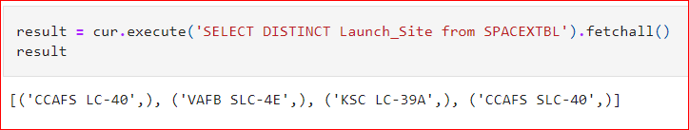
All Launch Site Names
Find the names of the unique launch sites
In order to extract data was used Python package sqlite3.
To get list of launch sites names was used SELECT DISTINCT statement. It returns list of tuples. The first element of each tuple is launch site name

Slide 25
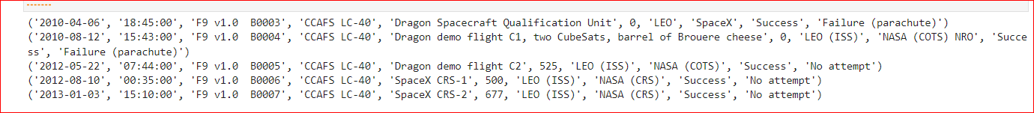
Launch Site Names Begin with 'CCA'
Find 5 records where launch sites begin with `CCA`
To get the first 5 records was used SELECT statement with condition ‘LIKE CCA%’ and ‘LIMIT 5’. It returns list of tuples as on screenshot
Each element of tuple contain all fields of the SPACEXTBL table

Slide 26
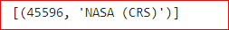
Total Payload Mass
To calculate the total payload carried by boosters from NASA was used sql query with condition for the Customer field
The query returns the tuple where the first element is total payload and the second is name of Customer

Slide 27
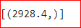
Average Payload Mass by F9 v1.1
To calculate the average payload mass carried by booster version F9 v1.1 was used following query
The query returns tuple where the first element is average payload mass

Slide 28
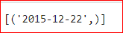
First Successful Ground Landing Date
To find the dates of the first successful landing outcome on ground pad was used the following query with using Min function for Date field
The query returns tuple where the first element is the first date

Slide 29
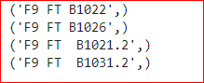
Successful Drone Ship Landing with Payload between 4000 and 6000
To get list the names of boosters which have successfully landed on drone ship and had payload mass greater than 4000 but less than 6000 was used the following query
The query returns list of tuples where the first element is Booster_Version

Slide 30
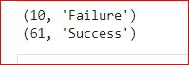
Total Number of Successful and Failure Mission Outcomes
To calculate the total number of successful and failure mission outcomes was used the query with ‘UNION’ statement
The query returns list of tuples where the first element is number of outcomes, the second type of outcome: “Failure” or “Success”

Slide 31
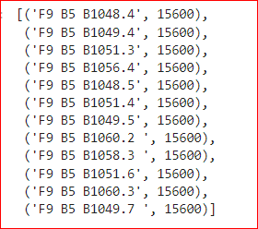
Boosters Carried Maximum Payload
To get list the names of the booster which have carried the maximum payload mass is used query with subquery, where subquery returns value of maximum payload
The Query returns list of tuples where the first element is booster version, the second is payload mass

Slide 32
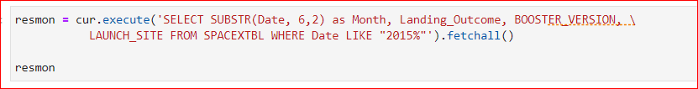
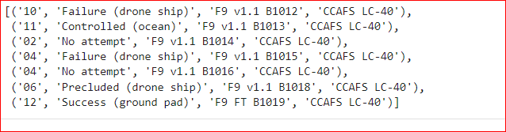
2015 Launch Records
To get list the failed landing_outcomes in drone ship, their booster versions, and launch site names for in year 2015 is used following query
The query returns list of tuple where each tuple contains month, status of outcome, booster version and launch site

Slide 33
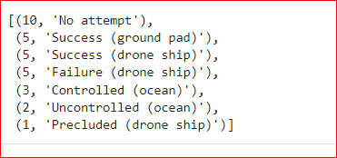
Rank Landing Outcomes Between 2010-06-04 and 2017-03-20
Rank the count of landing outcomes (such as Failure (drone ship) or Success (ground pad)) between the date 2010-06-04 and 2017-03-20, in descending order
The query returns the list of tuples ordered by descendence

Slide 34

Section 3

Slide 35
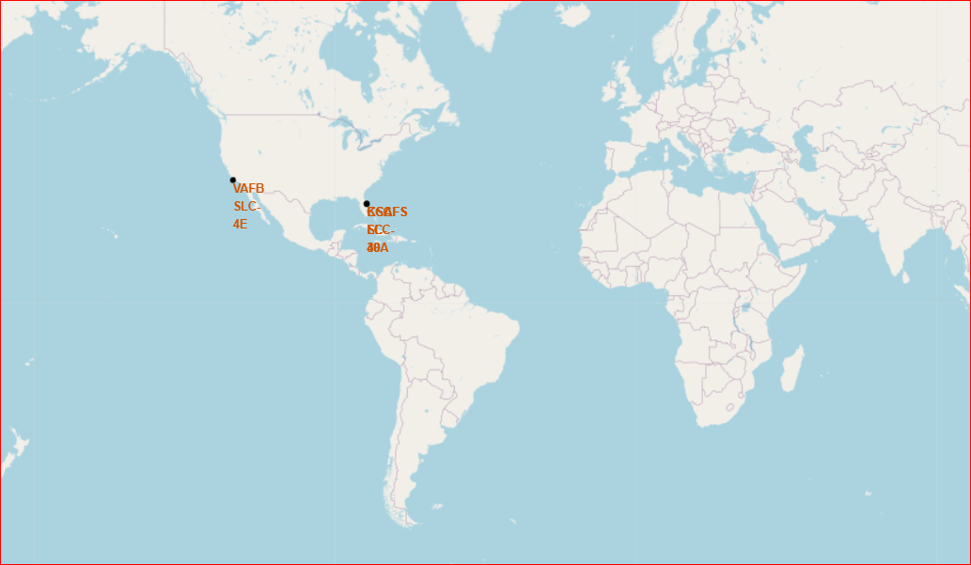
All Launch Sites on a Map
The screenshot contains the map with markerss for each Launch Site

Slide 36
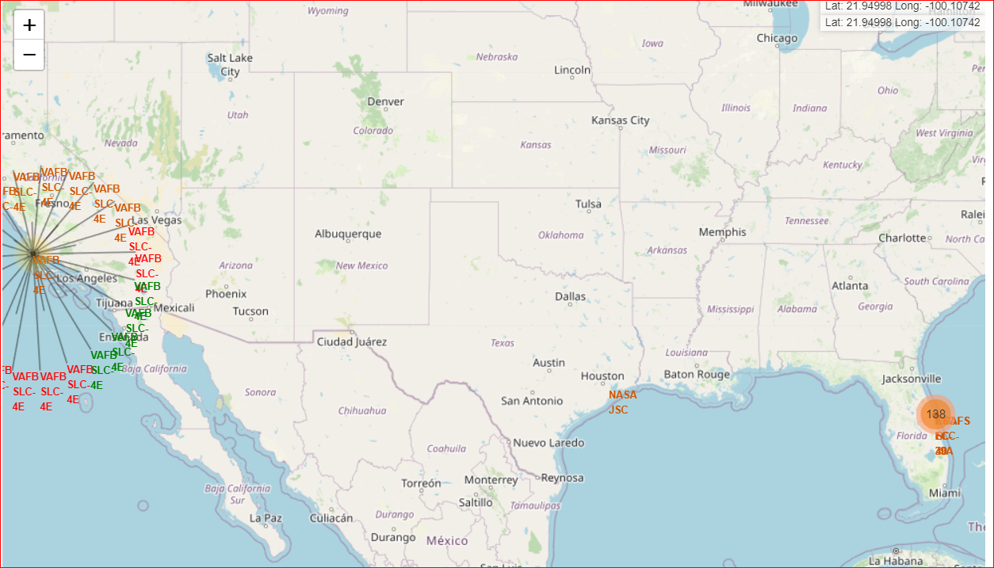
Mark the success/failed launches
Successful launch on this screenshot is marked by green, failed - red

Slide 37
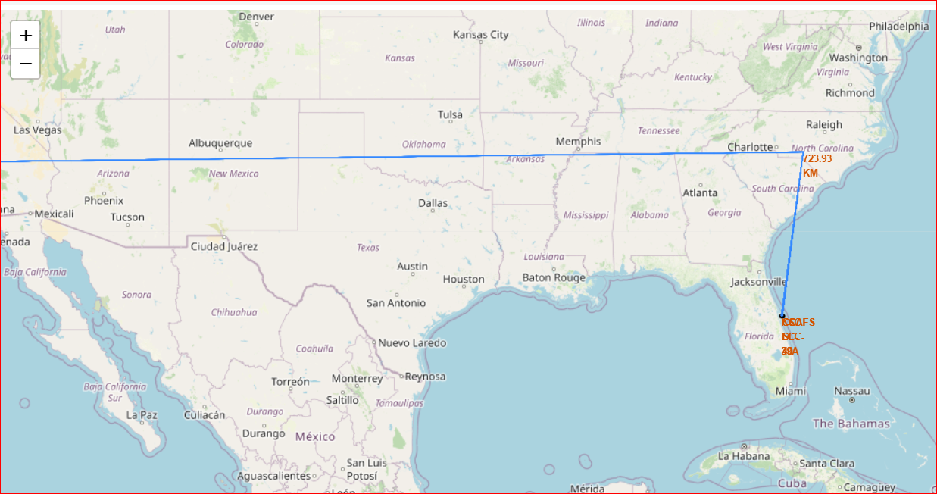
Distances between a launch site to its proximities
The poly line on this map shows distance to closest coasline

Slide 38

Section 4

Slide 39
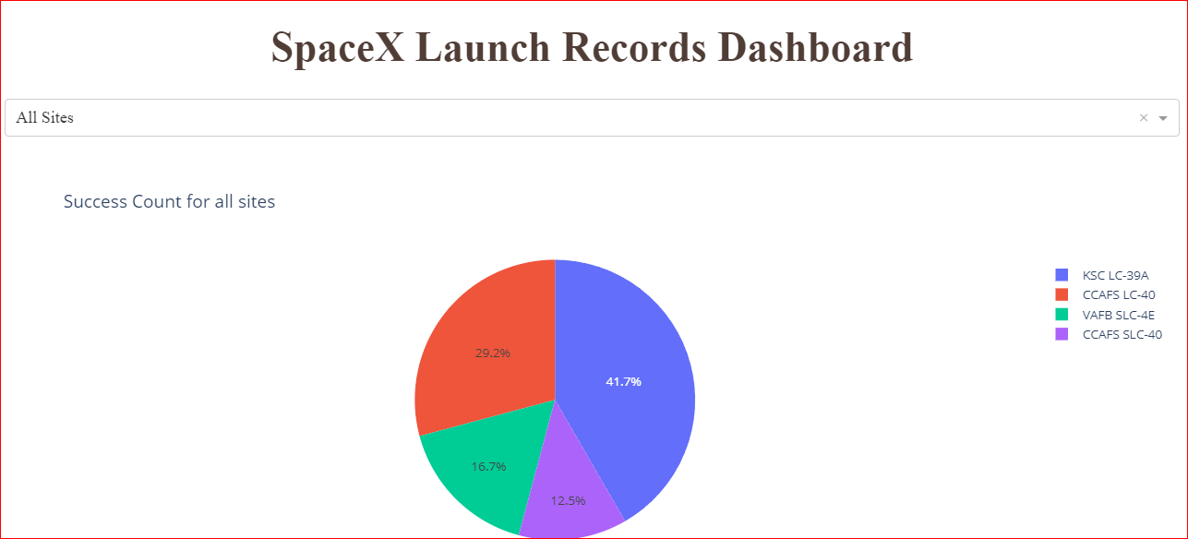
Launch Success Count Pie Chart for All Sites
This chart demonstrates success launches for all sites. It shows that KSC LC-39A had the most successful launches

Slide 40
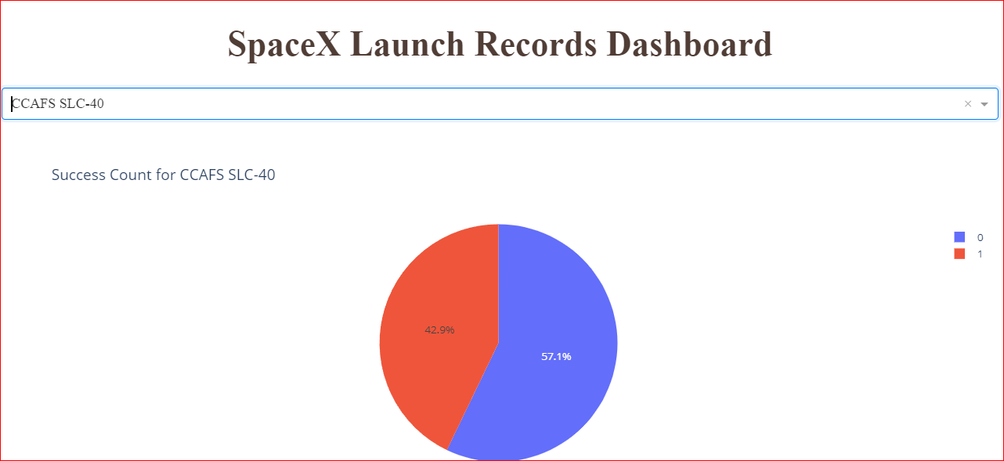
Pie Chart for Highest Launch Success
This chart demonstrates proportion between successful and failed launches for most successful site (CCAFS SLC-40)

Slide 41
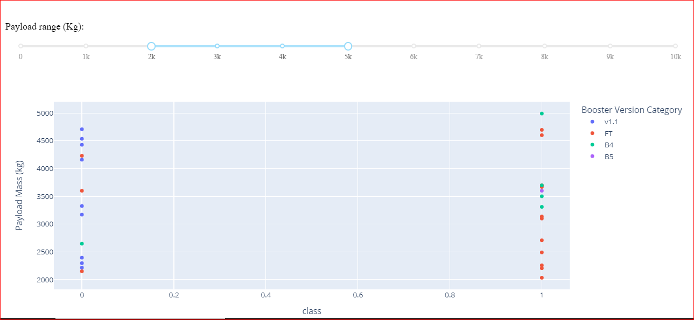
Payload vs. Launch Outcome for all sites
This scatterplot demonstrates all successful launches with payload between 2000 and 5000 by booster version categories

Slide 42

Section 5

Slide 43
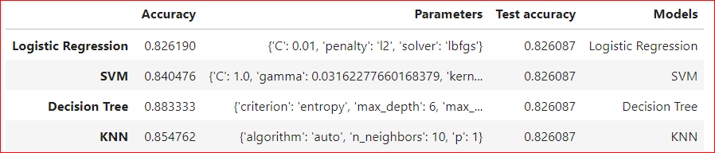
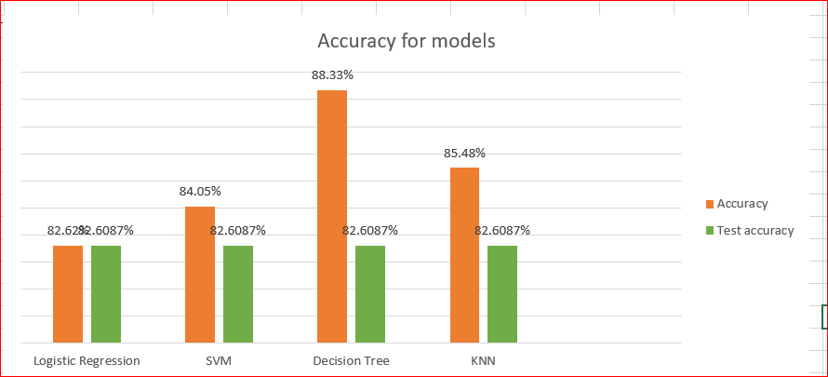
Classification Accuracy
Following table and Bar chart demonstrate best accuracy and parameters for each classification model (Logistic Regression, SVM, Decision Tree and KNN)
According to these reports the model which has the highest classification accuracy is Decision Tree

Slide 44
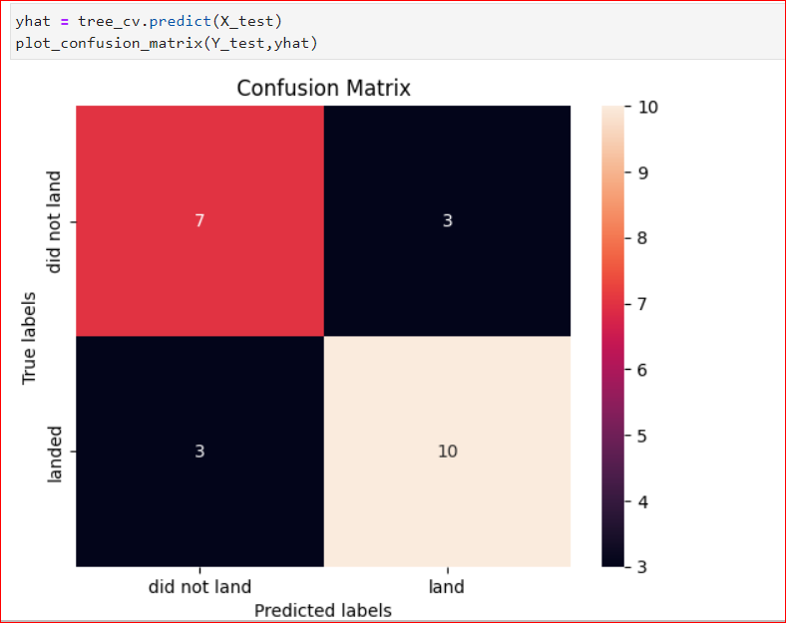
Confusion Matrix
A Confusion matrix is matrix used for evaluating the performance of a classification model. A good model should have high true positive (TP) rate and low true negative (TN)
The Desicion Tree model has TP = 10, TN = 7, and false positive rate and false negative rate as 3

Slide 45
Conclusions
The best orbit types for launches are orbit ‘ES-L1’, ‘GEO’, ‘HEO’.
The Success rate was growing since 2013 year through 2017, but after 2017 year success rate decreased sharply. Restoring of growth of success rate was began in 2018 year
The best machine learning algorithm for classification is Decision Tree
Total payload mass carried from NASA is 45596

Slide 46
Appendix

Slide 47


